Slide 1
Multiple Disease Prediction Using Machine Learning
By :
Ayush Sharma
Vansh PAtel

Slide 2
Index
Abstract
Introduction
System analysis
System design
Implantation & testing
Result
Conclusion
Future work

Slide 3
ABSTRACT
Machine learning is used across many ranges around the world. The healthcare industry is no exclusion .mlcan play an essential role in prediction presence labesence and locomotion disorder heart diseases ,cancer and moimpre such info, of predicted well in advance can provide instruction to doctors who can then adapt their diagnosis per patient basis.

Slide 4
INTRODUCTION
Background
objective
Purpose/scope

Slide 5
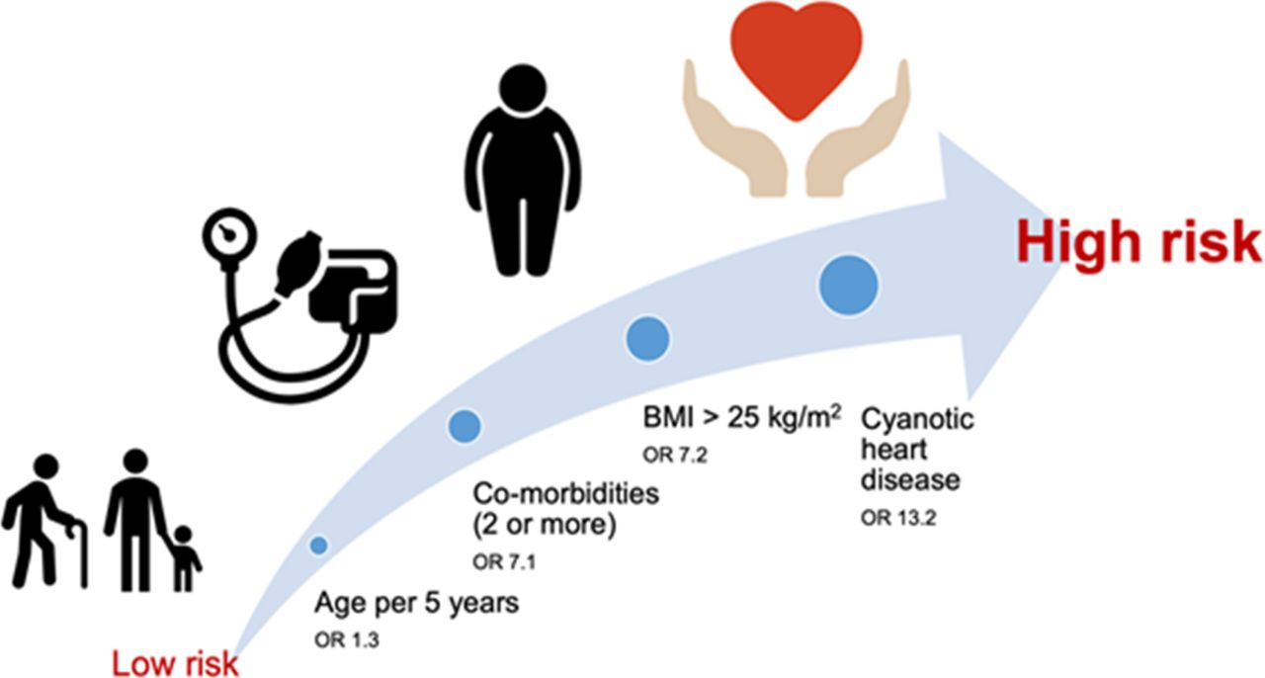
Background
According to the who every year more than 20 million death occur worldwide due to breast cancer heart disease
The prediction of chronic diseases are one of the most important subject in section of data analysis.

Slide 6

Objective
The main motives of doing this research is to present a multiple disease prediction model for the occurrence of multiple disease further this research work aimed towards identifying the best classification algorithms identification the possibilities of different disease

Slide 7
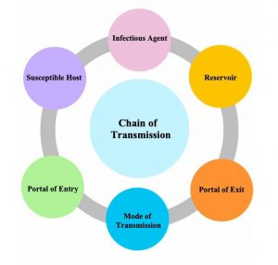
Purpose and Scope
Making prediction of various disease become easier and accurate which can help the patient for occurring disease and make healthy person.
(ML) system has becomes widely use day by day and make our daily lifestyle smoother and comfortable in short time.

Slide 8
System Analysis
Existing system
Proposed system
Software requirement
Hardware requirement

Slide 9
Existing System
The disease which we have predicted in our model are the disease which eventually cause the death of the person the nature of the disease keeps on changing .
The machine learning technique has given boon to prediction of disease with accuracy

Slide 10
Proposed System
The working of the system is to collect the dataset and prevent from various disease .The preprocessing of the model system is divided into two parts training and testing.
The algorithm used in the system are different for training and testing data.The accuracy of the system can be occurred by testing the dataset.

Slide 11
Software Requirements
i. Software: VS Code (Or any other); Google Colab
ii. Tools: Google Colab; Python IDLE or any
    Python tool and notebook tool.
iii. Front End: Python
iv. Back End: Python

Slide 12
Hardware Requirements
Dataset of disease which has to be predict
Desktop laptop with well processer
Ram with storage 512 mb or above
Details analysis of the project by servey

Slide 13
System design
Module division
E R diagram
UML diagram

Slide 14
Modulus Division
Dataset collection is collecting data which contains patient details. Attributes selection process selects the useful attributes for the prediction of heart disease. After identifying the available data resources, they are further selected, cleaned, made into the desired form. Different classification techniques as stated will be applied on preprocessed data to predict the accuracy of heart disease. Accuracy measure compares the accuracy of different classifiers.

Slide 15
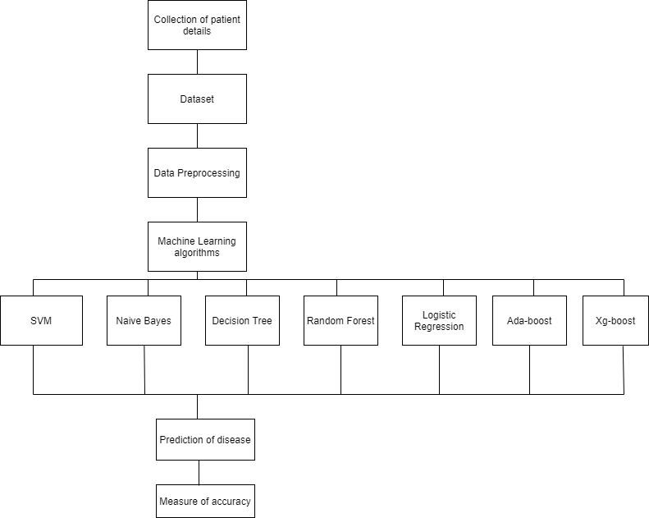
Modulus Diagram:

Slide 16
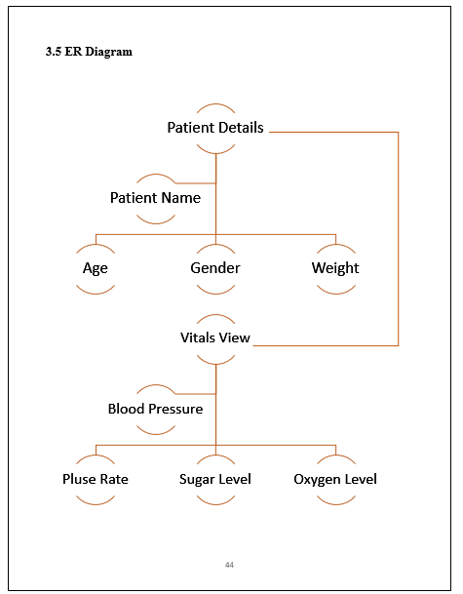
ER Diagram
An entity relationship diagram also known as an entity relationship model is a graphical representation .

Slide 17
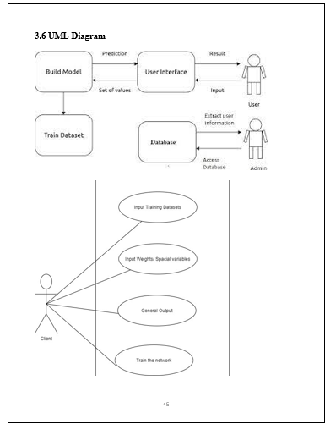
UML Diagram
Unified modeling language is a general purpose ,developmental ,modelling language in the field of software

Slide 18
Implantation
Here, the implantation part is been describe in detail information like where, how, and what kind of steps has been taken for creating this model of Multiple Disease Prediction System Using Machine Learning also, which platforms are used for this creation of model is been describe.
Download the dataset by visiting the website which is named as www.kaggle.com in this website multiple datasets of multiple disease are been uploaded.

Slide 19
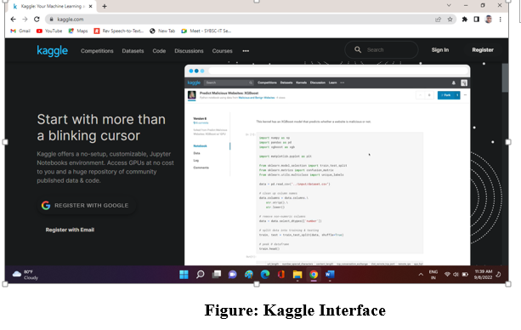

Slide 20
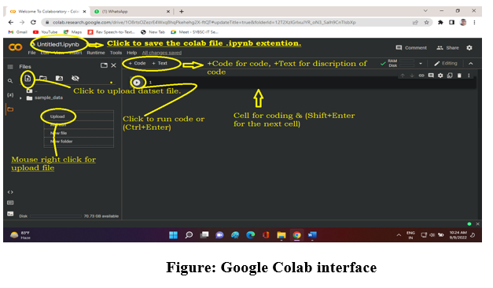
Implantation of dataset
Google Colab it is a notebook for python or any other programming language where we can perform code as we used to do in different python software. In this colab notebook we have done python code of running the dataset which we have downloaded from Kaggle.com.

Slide 21
Result
After performing the machine learning approach for testing and training we find that accuracy of the knn is much efficient as compare to other algorithms. It concluded that knn is the best among them with 87% accuracy and the comparison is shown in the below table. The presented result is as per the algorithm that is used in the model .

Slide 22
Conclusion
Heart diseases are a major killer in India and throughout the world , application of promising technology like machine learning to the initial prediction of the heart diseases will have a profound impact on society. The early prognosis of heart disease can aid in making decisions on lifestyle changes in high risk patient and in turn reduce the complications, which can be a great milestone in the field of machine. The number of people Facing heart diseases is on a raise each year.

Slide 23
Future Work
Using of machine learning prediction system will make the prediction system will make the prediction of various disease accurate and reable. Project aims to predict future multiple diseases by analyzing data of patients which classifies whether they have heart diseases or not using machine-learning algorithm.

Slide 24
REFERENCE
www.ww3school.com
www.kaggle.com.
Soni J, Ansari U, Sharma D & Soni S (2011). Predictive data mining for medical diagnosis: an overview of heart disease prediction. International Journal of Computer Applications, 17(8), 43-8
Dangare C S & Apte S S (2012). Improved study of heart disease prediction system using data mining classification techniques. International Journal of Computer Applications, 47(10), 44-8.

Slide 25
Thankyou

